Slide 1
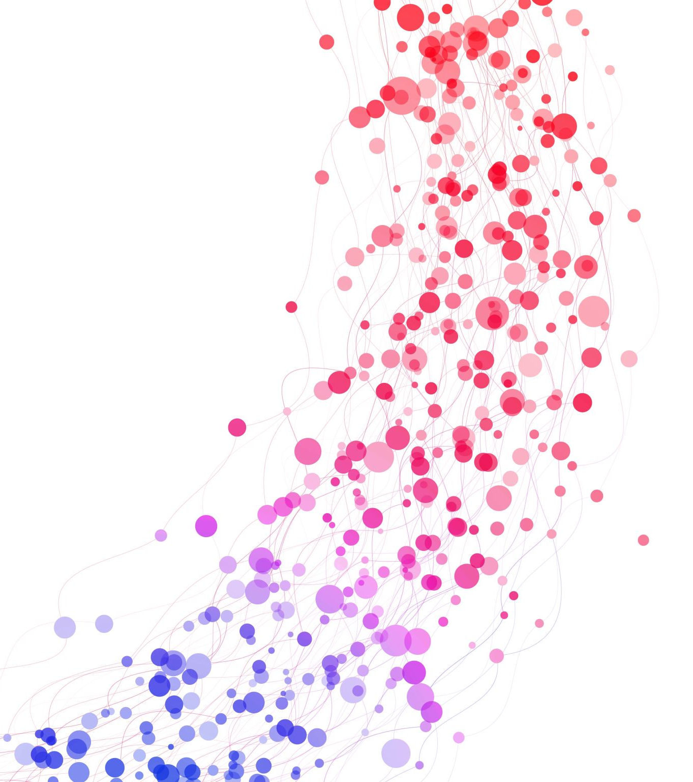

K-Nearest Neighbors(KNN) supervised learner
Hossam Ahmed Salah

Slide 2
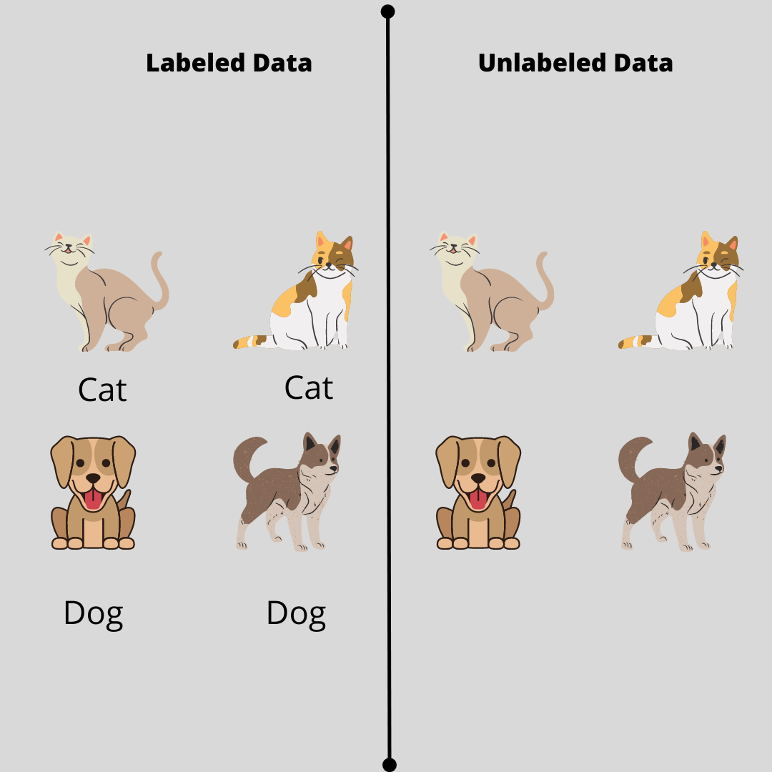
Machine Learning Tasks
ML task
Supervised
Classification
Regression
Unsupervised
Clustering
Reinforcement
Segmentation
Dimension reduction
Decision process
Reward system
Recommendation system
Data can be !
Labeled (Supervised)
Not labeled (Unsupervised)

Slide 3

Machine Learning Tasks
Supervised
Classification
(sunny, cloudy,..)
Regression
(33º)
Data can be !
Labeled (Supervised)
Not labeled (Unsupervised)

Slide 4
Variance
Measurement of spread in the dataset
مقياس لتباعد النقاط المختلفة من النقطة الوسط
High Variance

Slide 5
Variance
Measurement of spread in the dataset
مقياس لتباعد النقاط المختلفة من النقطة الوسط
Low Variance

Slide 6
Bias Error
In statistics, bias refers to the tendency of a statistical estimator or method to consistently overestimate or underestimate a population parameter
tendency which causes differences between results and facts
Bias in ML is a sort of mistake in which some aspects of a dataset are given more weight and/or representation than others
In ML bias inability to capture the underlying complexity of the data.

Slide 7
Overfitting and Underfitting
Considering we have this data, and we want to train a 2 models

Slide 8
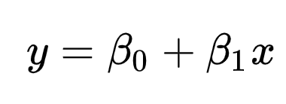
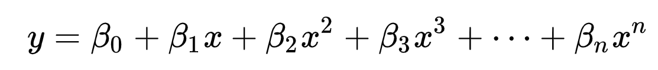
Overfitting and Underfitting
Models
Linear
Polynomial

Slide 9


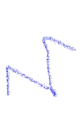

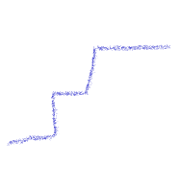
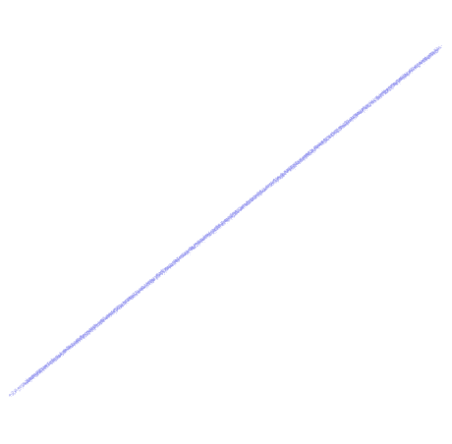

Overfitting and Underfitting
Considering we have this data, and we want to train a 2 models

Slide 10
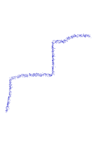

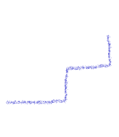
Overfitting and Underfitting
Only fit few points
Perfect fit of the trained data 100%

Slide 11


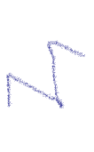

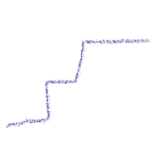

Overfitting and Underfitting
Unseen data in the training
Your model is terrible on real data not near even
Seeking perfection in train set lead to high variance model
This called overfitting

Slide 12
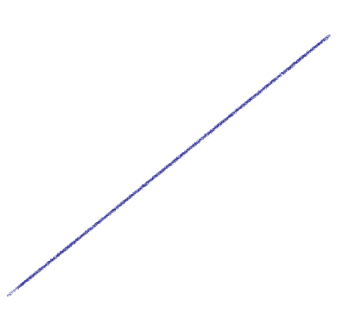
Overfitting and Underfitting
Unseen data in the training
What about the linear Model
Terrible model but we the training error and testing error is not too far
If average error is 20% for each point you can say that new points can be + or – 20%
This model has a high bias following the line doesn’t care about the data
This model underfit the data too simple to model it

Slide 13
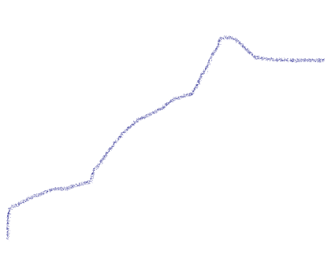
Overfitting and Underfitting
We need a mode that generalize
we shall tolerant some bias (error) in the training set
That mean making this model has less variance
It’s to simplify the model
We have errors in the training set
But we can have less error when dealing with new input
A Best fit trying to achieve balance between Bias(error, simplicity) and Variance (complexity)
It’s a tradeoff

Slide 14
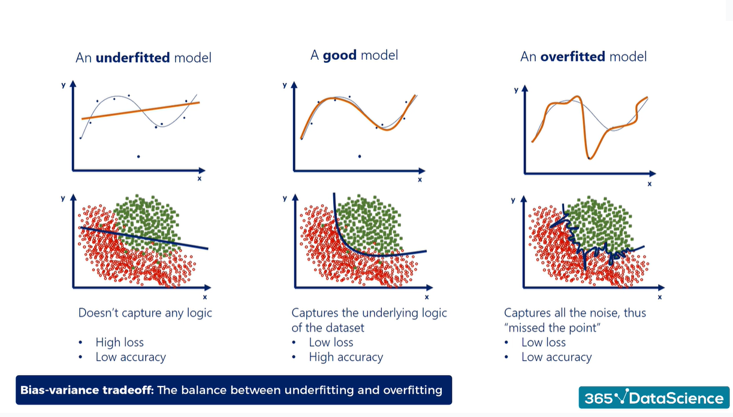

Slide 15
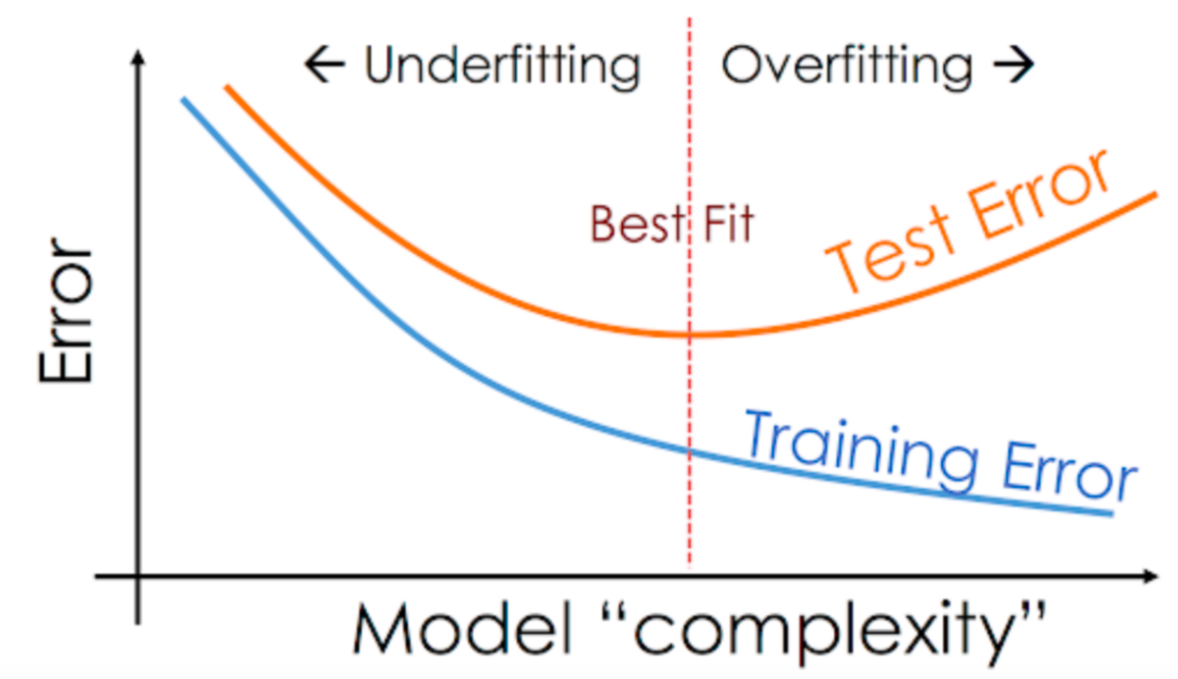

Slide 16
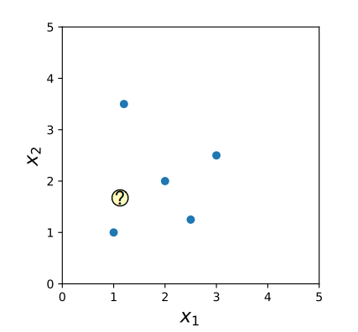
K-Nearest Neighbor (K-NN)
How KNN works ?
How to train 1-NN estimator ?(Training)
Memorize the training data

Slide 17
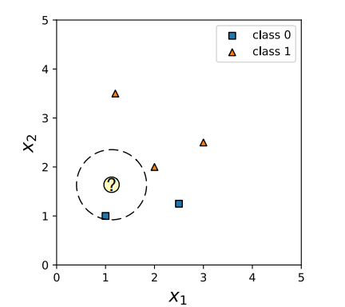
K-Nearest Neighbor (K-NN)
How KNN works ?
How 1-NN make predictions (Predicting)?
If you want to predict x, find the nearest point in the training to the unseen x point
The nearest training point to our unseen point would be our prediction

Slide 18
K-Nearest Neighbor (K-NN)
How KNN works ?
How 1-NN make predictions (Predicting)?
If you want to predict x, find the nearest point in the training to the unseen x point
The nearest training point to our unseen point would be our prediction

Slide 19
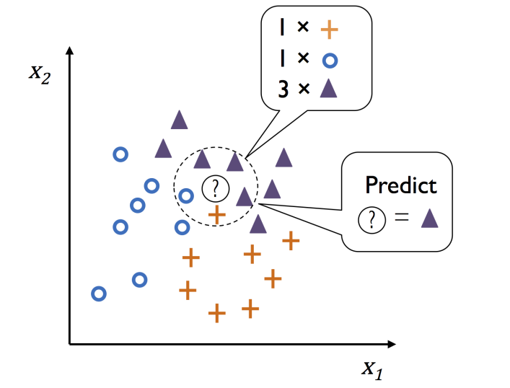
K-Nearest Neighbor (K-NN)
How KNN works ?
How k-NN make predictions (Predicting)?
Query point (unseen point❓)
K= 5 (asking 5 training points to vote)
We have 3 classes
See the k-nearest points from the unseen point and label it based on similarity of most points around it.

Slide 20
K-Nearest Neighbor (K-NN)
How KNN works ?
How k-NN make predictions (Predicting)?
Query point (unseen point❓)
K= 5 (asking 5 training points to vote)
We have 3 classes
See the k-nearest points from the unseen point and label it based on similarity of most points around it.

Slide 21
How to know the nearest point?
Of course, using distance
How to calculate the distance?

Slide 22
How to know the nearest point?
Of course, using distance
How to calculate the distance?
Euclidian distance (L2)

Slide 23
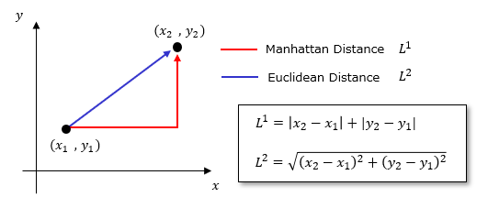
How to know the nearest point?
Of course, using distance
How to calculate the distance?
Euclidian distance (L2)
Manhattan distance (L1)

Slide 24
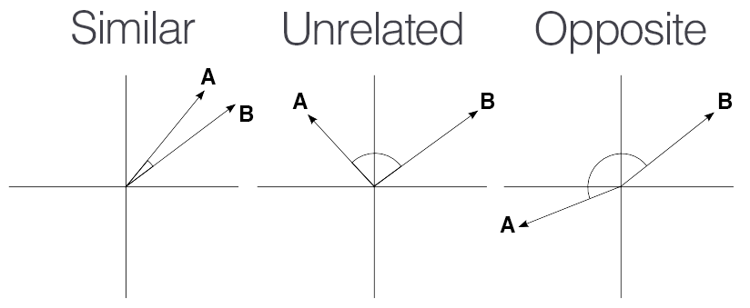
How to know the nearest point?
Of course, using distance
How to calculate the distance?
Euclidian distance (L2)
Manhattan distance (L1)
Cosine similarity
Distance Metric: A measure of how similar or dissimilar two data points are. Common distance metrics include Euclidean distance, Manhattan distance, and cosine similarity.

Slide 25
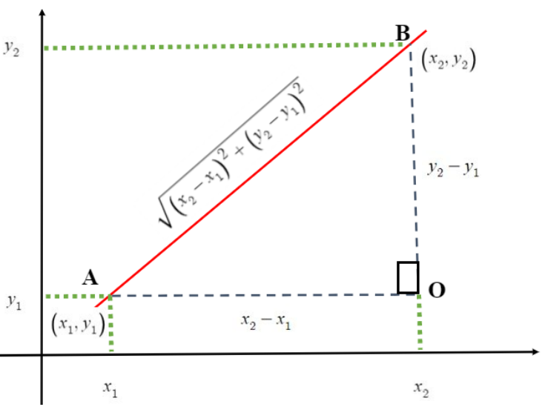
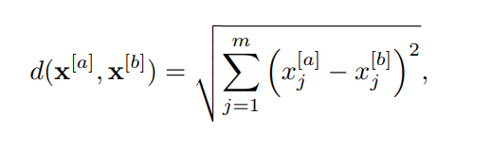
How to know the nearest point?
Distance Metric: A measure of how similar or dissimilar two data points are. Common distance metrics include Euclidean distance, Manhattan distance, and cosine similarity.
Of course, using distance
How to calculate the distance?
Euclidian distance (L2)
vectors in m dimensions
2D

Slide 26



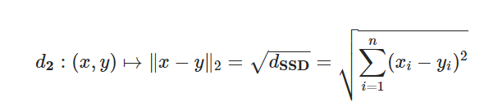
How to know the nearest point?
Other names of L2
How to calculate the distance?
Euclidian distance (L2)
Sum of Squared Difference (SSD)
Euclidean Distance
vectors in m dimensions

Slide 27
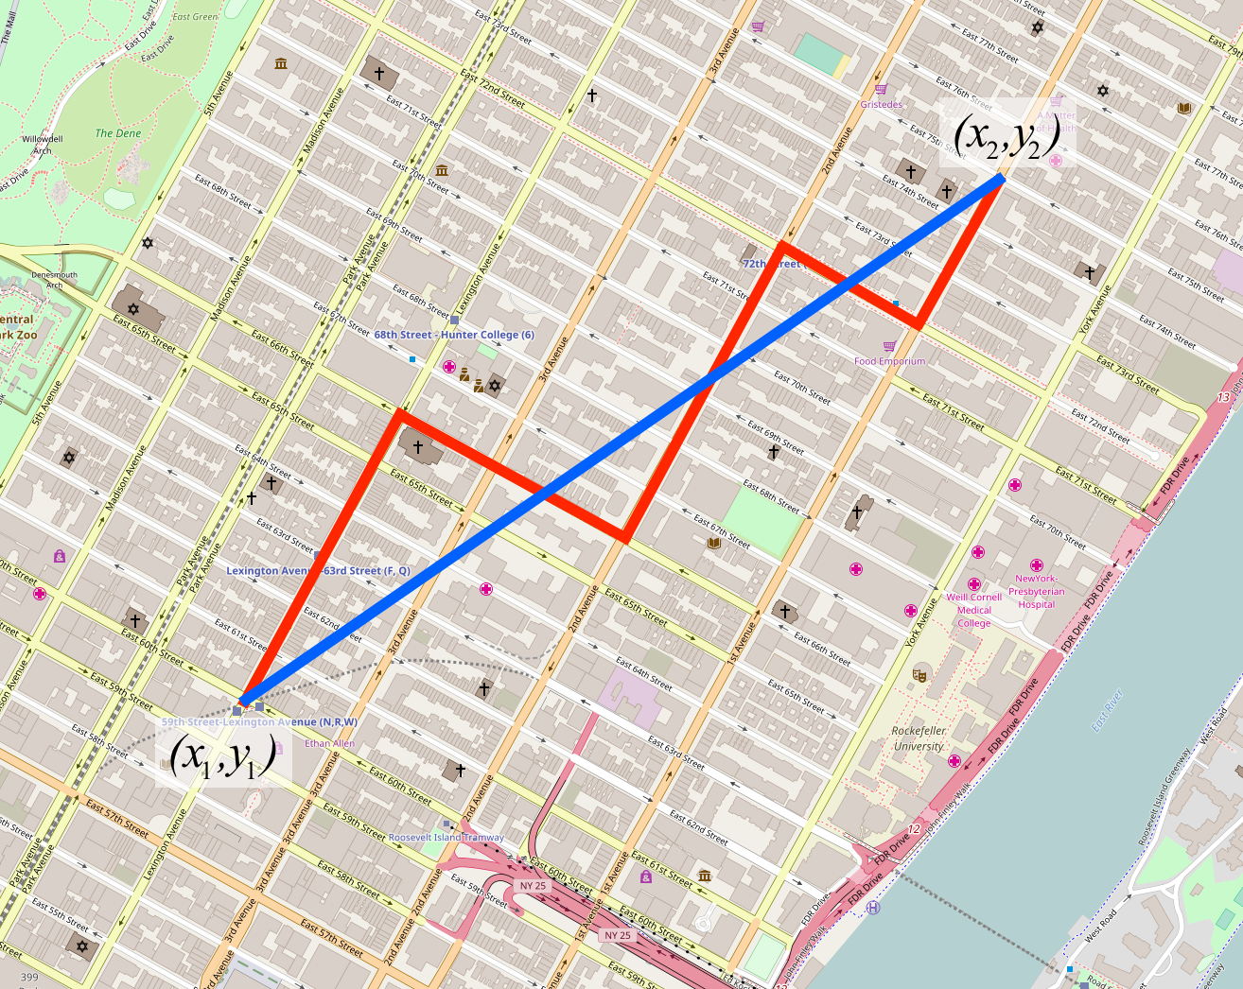


How to know the nearest point?
Other names of L1
How to calculate the distance?
Manhattan distance (L1)
Sum of Absolute Difference (SAD)

Slide 28
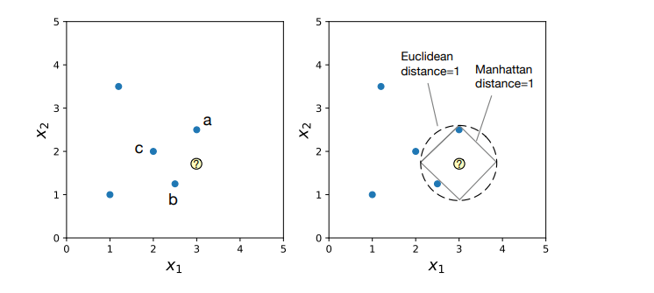
How to know the nearest point?

Slide 29
Features of KNN
Nonparametric model
Linear Regression for example is a parametric model f(X-train; Weights)
KNN non-parametric as it the k-NN just memorize the train data f(X-train) in the training phase that is why it’s also called a Lazy learner
Instance-based (memory based)
NN stores the entire training dataset in memory. Each data point in the training dataset is an "instance," and this dataset is used for making predictions
It only memorize the training data no learning or generalization of the data.
Prediction on the Fly: When you want to make a prediction for a new data point, KNN looks for the k-nearest neighbors to the new point in the training dataset and assigns a class label based on the majority class among these neighbors (for classification) or computes an average value (for regression).

Slide 30
Advantages of K-NN
Easy to implement: Given the algorithm’s simplicity and accuracy, it is one of the first classifiers that a new data scientist will learn.
Adapts easily: As new training samples are added, the algorithm adjusts to account for any new data since all training data is stored into memory.
Few hyperparameters: KNN only requires a k value and a distance metric, which is low when compared to other machine learning algorithms.

Slide 31
Disadvantages of K-NN
Memory Usage: KNN is memory-intensive, especially with large datasets, as it needs to store the entire training dataset in memory.
Curse of dimensionality: it doesn’t perform well with high-dimensional data inputs.
Prone to overfitting
Sensitivity to Feature Scaling: KNN is sensitive to the scale of features. Features with larger ranges can dominate the distance calculations. Standardizing or normalizing features is often required.

Slide 32
Disadvantages of K-NN
Computational Complexity: The main drawback of KNN is its computational intensity. It needs to compute distances between the query point and all training instances, which can be slow for large datasets
Choosing the right value for "k" is critical. A small k can lead to noisy predictions, while a large k can lead to oversmoothed decisions. Selecting an optimal value for k can be challenging. (odd k is preferred specially in binary classification to avoid ties in voting ) we can use Elbow method also

Slide 33


Disadvantages of K-NN
(odd k is preferred specially in binary classification to avoid ties in voting ) we can use Elbow method also
$$k=2$$
$$k=3$$
🔴🔵
🔴🔵🔵

Slide 34
Disadvantages of K-NN
(odd k is preferred specially in binary classification to avoid ties in voting ) we can use Elbow method also
$$k=2$$
$$k=3$$
🔴🔵
🔴🔵🔵

Slide 35
Tips to build a good KNN
Choosing the value of k.
Odd k (classification)
Elbow method
Scaling of the feature axes.
Scaling is important for distance and gradient based models
Choice of distance measure.
Grid search

Slide 36
References
https://numerics.mathdotnet.com/Distance
https://en.wikipedia.org/wiki/Plurality_voting
https://sebastianraschka.com/pdf/lecture-notes/stat479fs18/02_knn_notes.pdf
https://en.wikipedia.org/wiki/K-nearest_neighbors_algorithm
https://github.com/hossamAhmedSalah/Machine_Learning_MSP [some reused slides and concepts]
https://sebastianraschka.com/pdf/lecturenotes/stat479fs18/02_knn_notes.pdf
https://pages.stat.wisc.edu/~sraschka/teaching/stat479-fs2018/
https://github.com/rasbt/stat479-machine-learning-fs18/
https://www.ibm.com/topics/knn
https://docs.google.com/presentation/d/1jOzBsDaLhZdw4GoyWoszcbl4KrTHmwlP/edit#slide=id.p18

